Slide 1
Recovery System

Slide 2
Basics
Why database recovery?
To overcome the loss of information in case of any system crash or failure.
To ensure that the atomicity and durability properties of transactions are preserved.
How?
By applying a recovery scheme.
What does a recovery scheme do?
Restores the database to a consistent state that existed before the failure.
Provides high availability (i.e. minimizes the time of unusability after a crash) of the database.

Slide 3
Types of Failure
The database may become unavailable for use due to
Transaction failure:
Logical errors: transaction cannot complete due to some internal error condition
System errors: the database system must terminate an active transaction due to an error condition (e.g., deadlock)
System failure: System may fail because of addressing error, application error, operating system fault, RAM failure, etc.
Media failure: Disk head crash, power disruption, etc

Slide 4
Recovery Algorithms
Recovery algorithms are techniques to ensure database consistency and transaction atomicity and durability despite failures
Recovery algorithms have two parts
Actions taken during normal transaction processing to ensure enough information exists to recover from failures
Actions taken after a failure to recover the database contents to a state that ensures atomicity, consistency and durability

Slide 5
Data Access
Physical blocks are those blocks residing on the disk.
Buffer blocks are the blocks residing temporarily in main memory.
Block movements between disk and main memory are initiated through the following two operations:
input(B) transfers the physical block B to main memory.
output(B) transfers the buffer block B to the disk and replaces the appropriate physical block there.
We assume, for simplicity, that each data item fits in, and is stored inside, a single block.

Slide 6
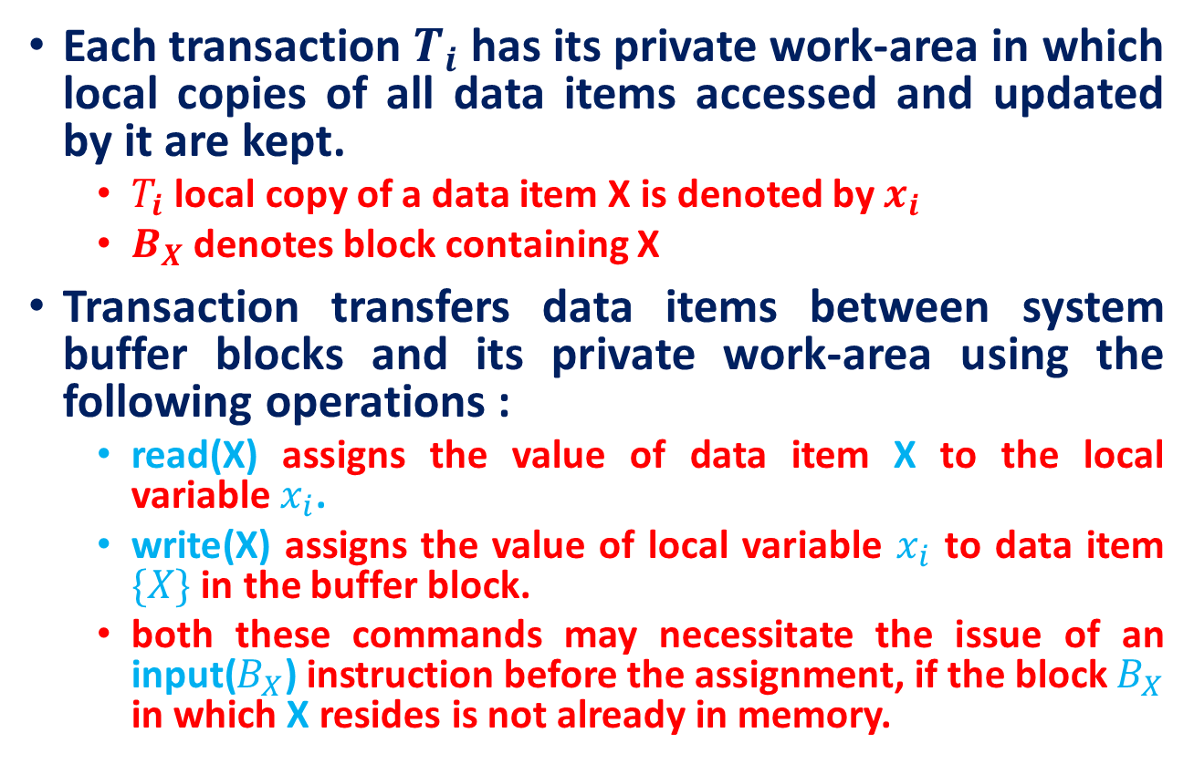
Data Access
Each transaction $T_{i}$ has its private work-area in which local copies of all data items accessed and updated by it are kept.
$T_{i}$ local copy of a data item X is denoted by $x_{i}$
$B_{X}$ denotes block containing X
Transaction transfers data items between system buffer blocks and its private work-area using the following operations :
read(X) assigns the value of data item X to the local variable $x_{i}$.
write(X) assigns the value of local variable $x_{i}$ to data item $\{X\}$ in the buffer block.
both these commands may necessitate the issue of an input($B_{X}$) instruction before the assignment, if the block $B_{X}$ in which X resides is not already in memory.

Slide 7
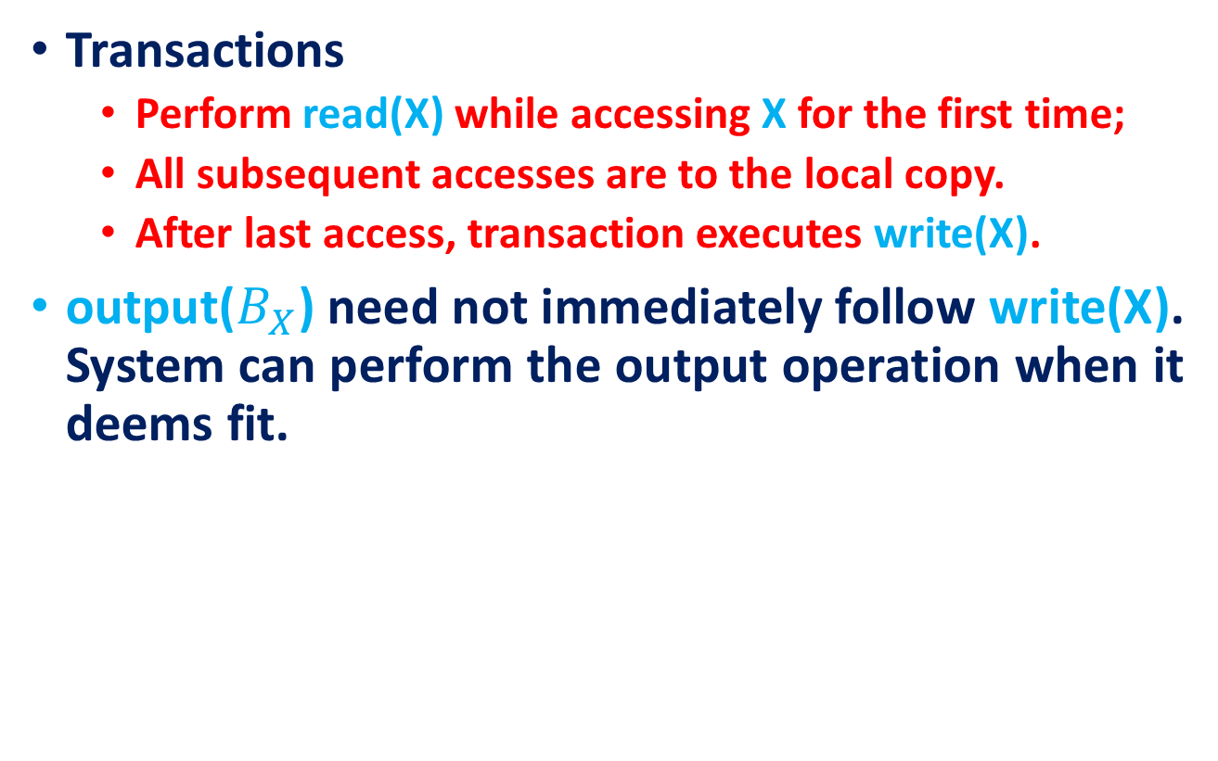
Data Access
Transactions
Perform read(X) while accessing X for the first time;
All subsequent accesses are to the local copy.
After last access, transaction executes write(X).
output($B_{X}$) need not immediately follow write(X). System can perform the output operation when it deems fit.

Slide 8
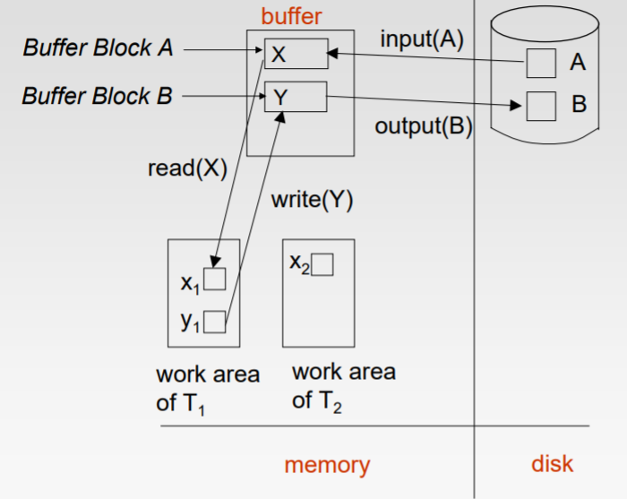
Example of Data Access Example of Data Access

Slide 9
Recovery and Atomicity
We study two approaches:
log-based recovery, and
shadow-paging
We assume (initially) that transactions run serially, that is, one after the other.

Slide 10
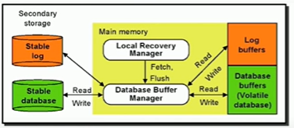
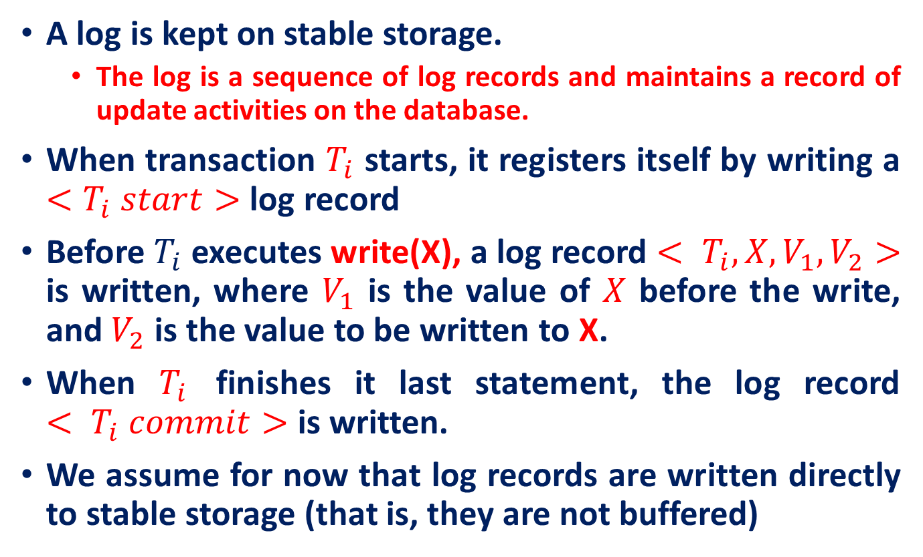
Log-Based Recovery
A log is kept on stable storage.
The log is a sequence of log records and maintains a record of update activities on the database.
When transaction $T_{i}$ starts, it registers itself by writing a $<T_{i} start>$ log record
Before $T_{i}$ executes write(X), a log record $< T_{i}, X, V_{1}, V_{2}>$ is written, where $V_{1}$ is the value of $X$ before the write, and $V_{2}$ is the value to be written to X.
When $T_{i}$ finishes it last statement, the log record $< T_{i} commit>$ is written.
We assume for now that log records are written directly to stable storage (that is, they are not buffered)

Slide 11
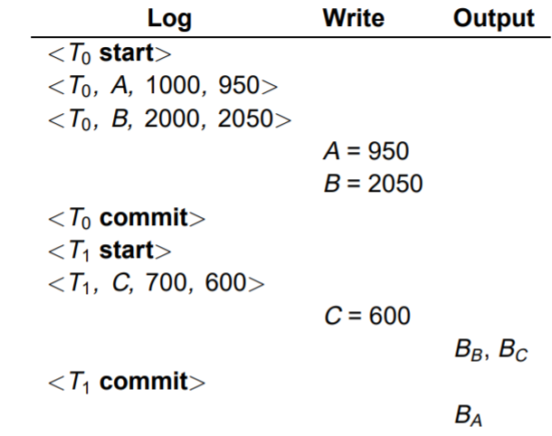

Immediate Database Modification
This scheme allows database updates of an uncommitted transaction to be made as the writes are issued; since undoing may be needed, update logs must have both old value and new value
Update log record must be written before database item is written
Output of updated blocks can take place at any time before or after transaction commit
Order in which blocks are output can be different from the order in which they are written.
Note: $B_{X}$ denotes block containing X

Slide 12
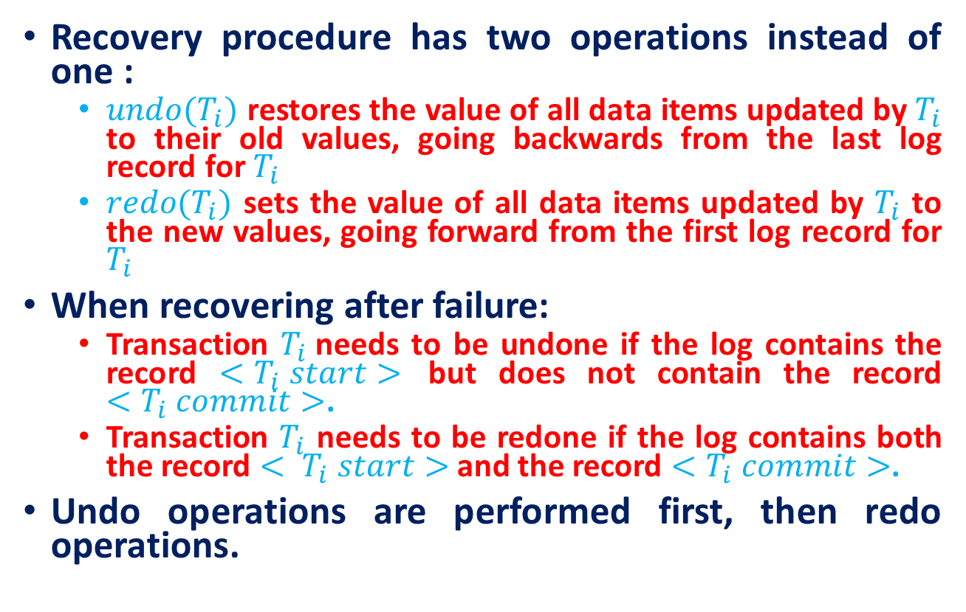
Immediate Database Modification
Recovery procedure has two operations instead of one :
$undo(T_{i})$ restores the value of all data items updated by $T_{i}$ to their old values, going backwards from the last log record for $T_{i}$
$redo(T_{i})$ sets the value of all data items updated by $T_{i}$ to the new values, going forward from the first log record for $T_{i}$
When recovering after failure:
Transaction $T_{i}$needs to be undone if the log contains the record $<T_{i} start>$ but does not contain the record $<T_{i} commit>$.
Transaction $T_{i}$ needs to be redone if the log contains both the record $< T_{i} start>$ and the record $<T_{i} commit>$.
Undo operations are performed first, then redo operations.

Slide 13
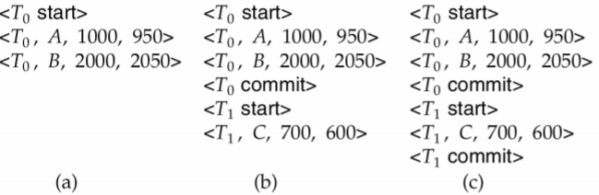

Immediate Database Modification
Below we show the log as it appears at three instances of time.
Recovery actions in each case above are:
$undo(T_{0})$: B is restored to 2000 and A to 1000.
$undo (T_{1})$ and redo (T0): C is restored to 700, and then A and B are set to 950 and 2050 respectively.
$redo (T_{0})$ and redo (T1): A and B are set to 950 and 2050 respectively. Then C is set to 600

Slide 14
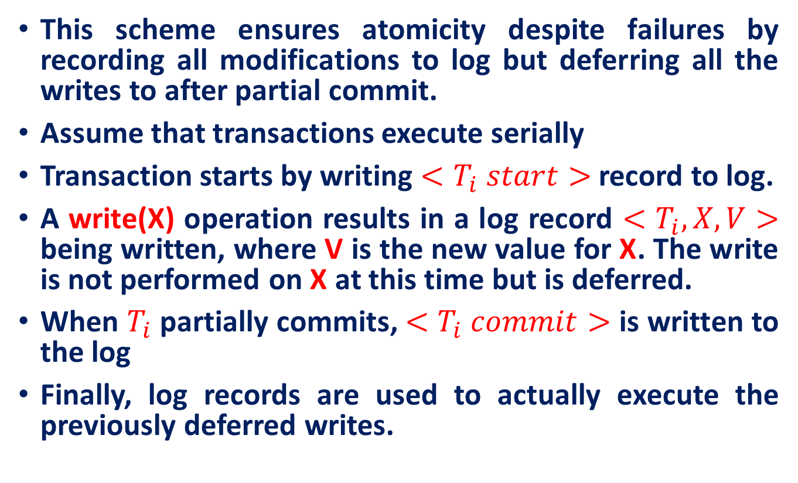
Deferred Database Modification
This scheme ensures atomicity despite failures by recording all modifications to log but deferring all the writes to after partial commit.
Assume that transactions execute serially
Transaction starts by writing $<T_{i} start>$ record to log.
A write(X) operation results in a log record $<T_{i}, X, V>$ being written, where V is the new value for X. The write is not performed on X at this time but is deferred.
When $T_{i}$partially commits, $<T_{i} commit>$ is written to the log
Finally, log records are used to actually execute the previously deferred writes.

Slide 15
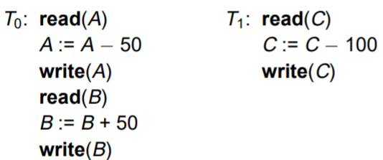
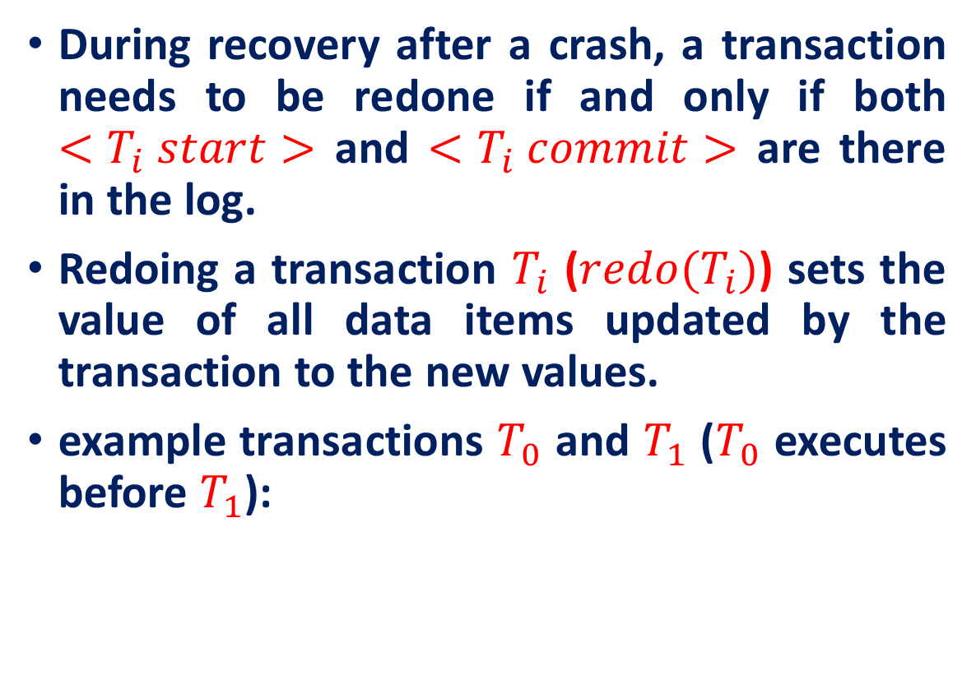
Deferred Database Modification
During recovery after a crash, a transaction needs to be redone if and only if both $<T_{i} start>$ and $<T_{i} commit>$ are there in the log.
Redoing a transaction $T_{i}$ ($redo(T_{i})$) sets the value of all data items updated by the transaction to the new values.
example transactions $T_{0}$ and $T_{1}$ ($T_{0}$ executes before $T_{1}$):

Slide 16
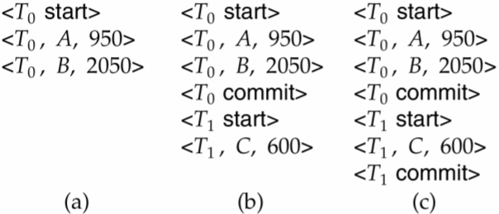

Deferred Database Modification
Below we show the log as it appears at three instances of time.
If log on stable storage at time of crash is as in case:
No redo actions need to be taken
redo($T_{0}$) must be performed since is present
redo($T_{0}$) must be performed followed by $redo(T_{1})$

Slide 17
Checkpoints
Problems in recovery procedure as discussed earlier :
searching the entire log is time-consuming
we might unnecessarily redo transactions which have already output their updates to the database.
Streamline recovery procedure by periodically performing checkpointing
Output all log records currently residing in main memory onto stable storage.
Output all modified buffer blocks to the disk.
Write a log record < checkpoint> onto stable storage.

Slide 18
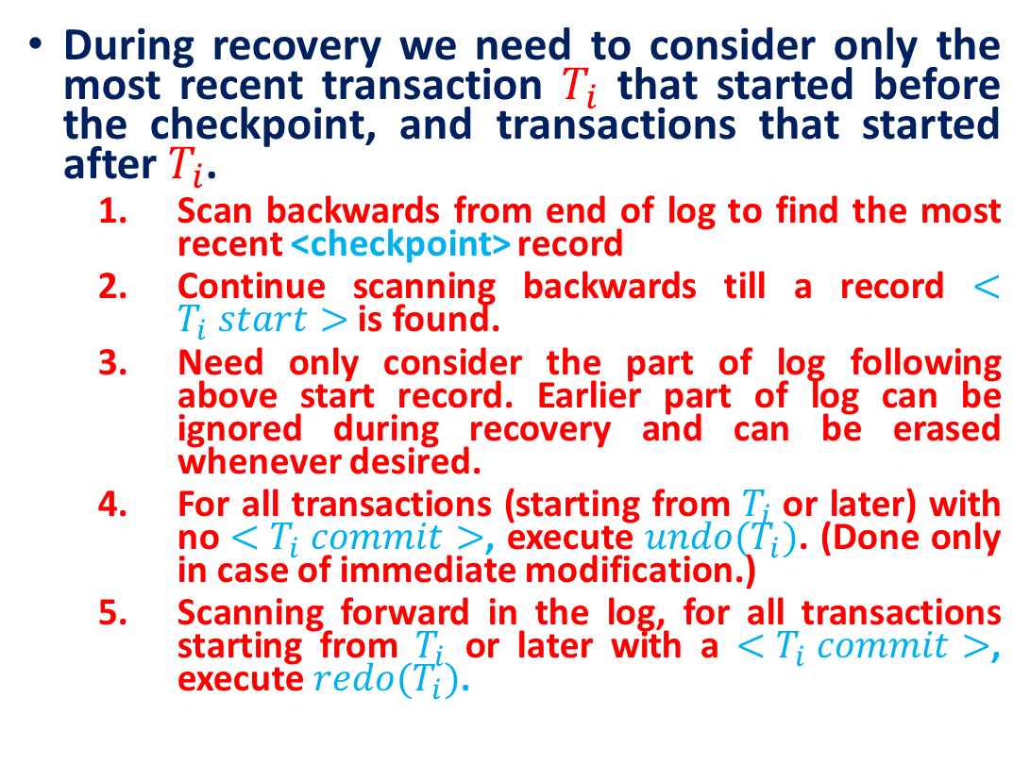
Checkpoints
During recovery we need to consider only the most recent transaction $T_{i}$ that started before the checkpoint, and transactions that started after $T_{i}$.
Scan backwards from end of log to find the most recent <checkpoint> record
Continue scanning backwards till a record $<T_{i} start>$ is found.
Need only consider the part of log following above start record. Earlier part of log can be ignored during recovery and can be erased whenever desired.
For all transactions (starting from $T_{i}$or later) with no $<T_{i} commit>$, execute $undo(T_{i})$. (Done only in case of immediate modification.)
Scanning forward in the log, for all transactions starting from $T_{i}$ or later with a $<T_{i} commit>$, execute $redo(T_{i})$.

Slide 19
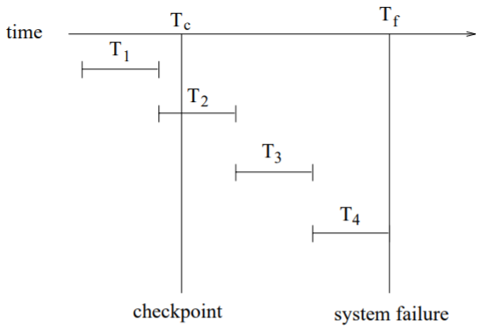
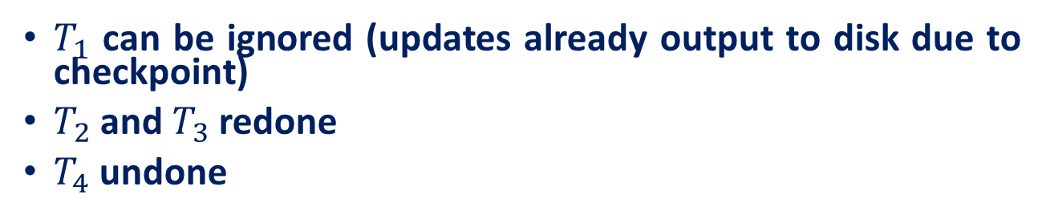
Example of Checkpoints Example of Checkpoints
$T_{1}$ can be ignored (updates already output to disk due to checkpoint)
$T_{2}$ and $T_{3}$ redone
$T_{4}$ undone

Slide 20
Shadow Paging
Alternative to log-based recovery
Idea: maintain two page tables during the lifetime of a transaction – the current page table, and the shadow page table
Store the shadow page table in nonvolatile storage, such that state of the database prior to transaction execution may be recovered. Shadow page table is never modified during execution
To start with, both the page tables are identical. Only current page table is used for data item accesses during execution of the transaction.
Whenever any page is about to be written for the first time, a copy of this page is made onto an unused page. The current page table is then made to point to the copy, and the update is performed on the copy

Slide 21
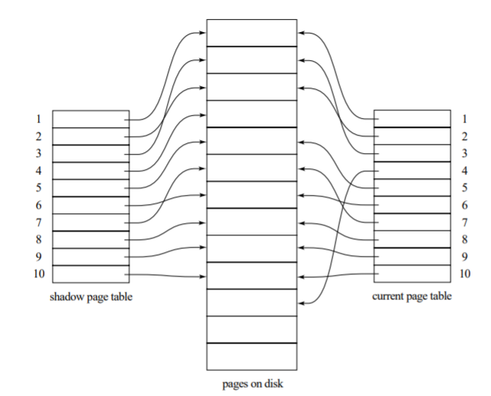
Example of Shadow Paging
Shadow and current page tables after write to page 4

Slide 22
Shadow Paging
To commit a transaction:
Flush all modified pages in main memory to disk
Output current page table to disk
Make the current page the new shadow page table
keep a pointer to the shadow page table at a fixed (known) location on disk.
to make the current page table the new shadow page table, simply update the pointer to point to current page table on disk
Once pointer to shadow page table has been written, transaction is committed.
No recovery is needed after a crash — new transactions can start right away, using the shadow page table.
Pages not pointed to from current/shadow page table should be freed (garbage collected).

Slide 23
Shadow Paging
Advantages of shadow-paging over log-based schemes – no overhead of writing log records; recovery is trivial
Disadvantages :
Commit overhead is high (many pages need to be flushed)
Data gets fragmented (related pages get separated)
After every transaction completion, the database pages containing old versions of modified data need to be garbage collected and put into the list of unused pages
Hard to extend algorithm to allow transactions to run concurrently

Slide 24
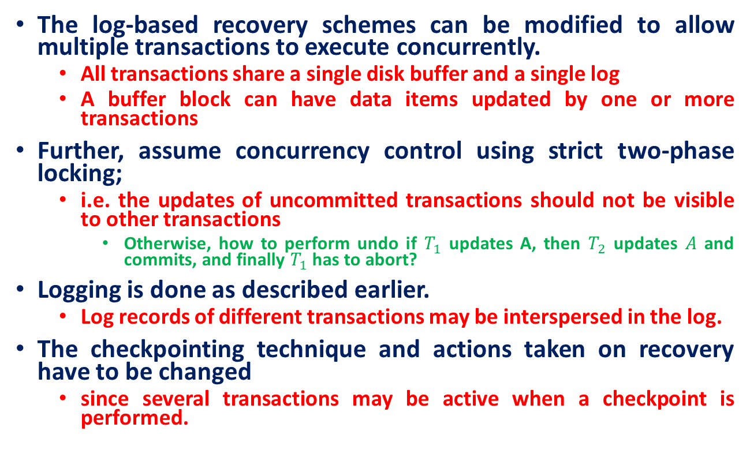
Recovery with Concurrent Transactions
The log-based recovery schemes can be modified to allow multiple transactions to execute concurrently.
All transactions share a single disk buffer and a single log
A buffer block can have data items updated by one or more transactions
Further, assume concurrency control using strict two-phase locking;
i.e. the updates of uncommitted transactions should not be visible to other transactions
Otherwise, how to perform undo if $T_{1}$ updates A, then $T_{2}$ updates $A$ and commits, and finally $T_{1}$ has to abort?
Logging is done as described earlier.
Log records of different transactions may be interspersed in the log.
The checkpointing technique and actions taken on recovery have to be changed
since several transactions may be active when a checkpoint is performed.

Slide 25
Recovery with Concurrent Transactions
Checkpoints are performed as before, except that the checkpoint log record is now of the form < checkpoint L>
where L is the list of transactions active at the time of the checkpoint
assume no updates are in progress while the checkpoint is carried out

Slide 26
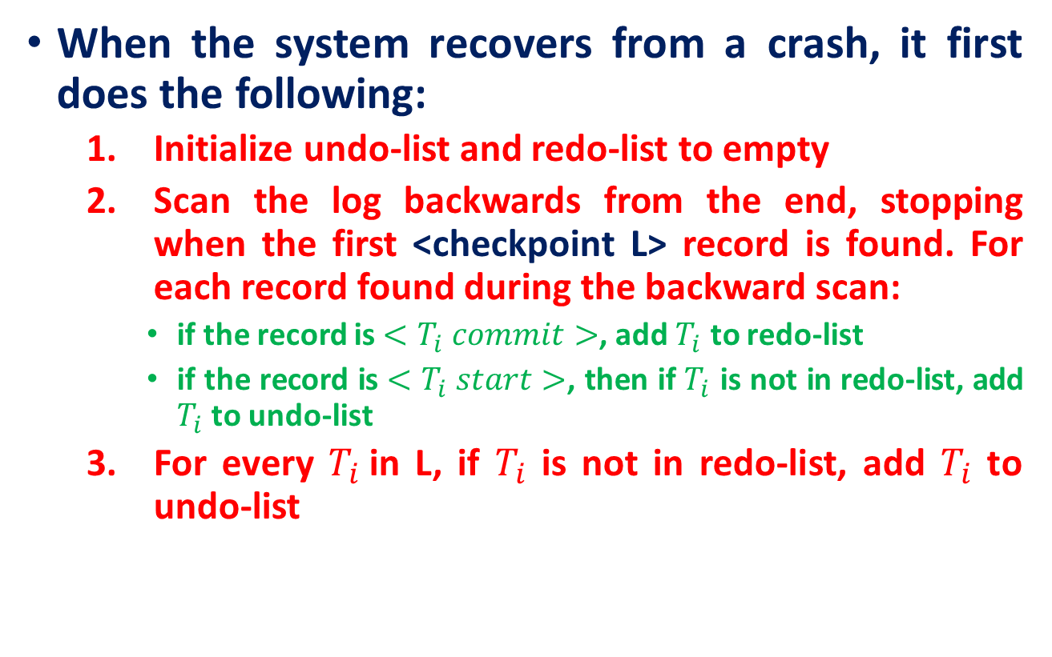
Recovery with Concurrent Transactions
When the system recovers from a crash, it first does the following:
Initialize undo-list and redo-list to empty
Scan the log backwards from the end, stopping when the first <checkpoint L> record is found. For each record found during the backward scan:
if the record is $<T_{i} commit>$, add $T_{i}$ to redo-list
if the record is $<T_{i} start>$, then if $T_{i}$ is not in redo-list, add $T_{i}$ to undo-list
For every $T_{i}$in L, if $T_{i}$ is not in redo-list, add $T_{i}$ to undo-list

Slide 27
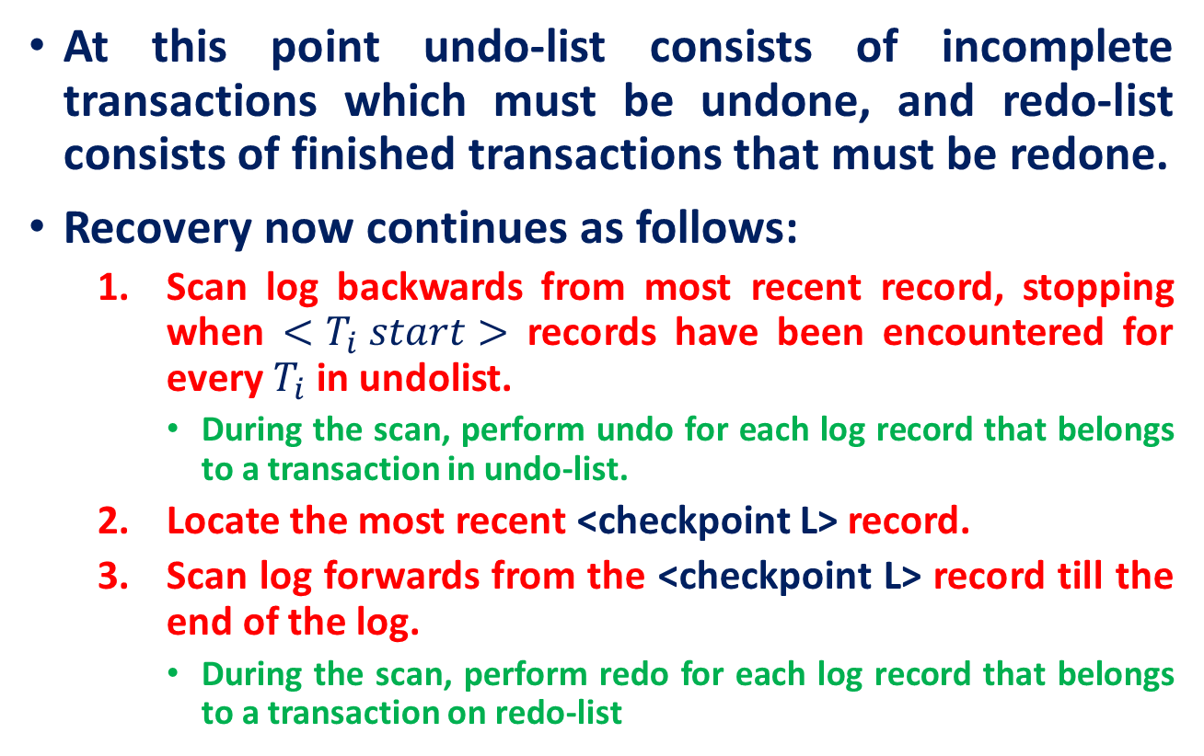
Recovery with Concurrent Transactions
At this point undo-list consists of incomplete transactions which must be undone, and redo-list consists of finished transactions that must be redone.
Recovery now continues as follows:
Scan log backwards from most recent record, stopping when $<T_{i} start>$ records have been encountered for every $T_{i}$in undolist.
During the scan, perform undo for each log record that belongs to a transaction in undo-list.
Locate the most recent <checkpoint L> record.
Scan log forwards from the <checkpoint L> record till the end of the log.
During the scan, perform redo for each log record that belongs to a transaction on redo-list

Slide 28
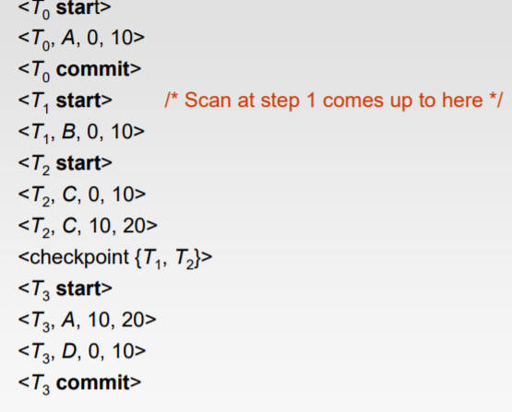
Example of Recovery
Go over the steps of the recovery algorithm on the following log:

Slide 29
Log Record Buffering
Log record buffering: log records are buffered in main memory, instead of of being output directly to stable storage.
Log records are output to stable storage when a block of log records in the buffer is full, or a log force operation is executed.
Log force is performed to commit a transaction by forcing all its log records (including the commit record) to stable storage.
Several log records can thus be output using a single output operation, reducing the I/O cost.

Slide 30
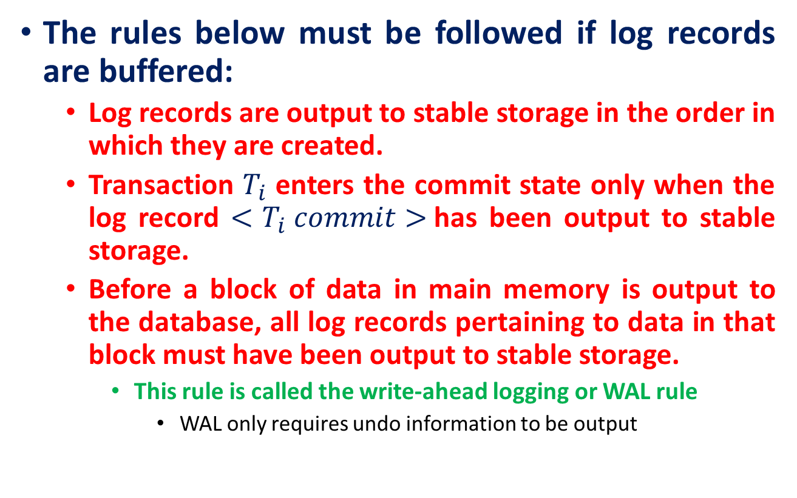
Log Record Buffering
The rules below must be followed if log records are buffered:
Log records are output to stable storage in the order in which they are created.
Transaction $T_{i}$ enters the commit state only when the log record $<T_{i} commit>$has been output to stable storage.
Before a block of data in main memory is output to the database, all log records pertaining to data in that block must have been output to stable storage.
This rule is called the write-ahead logging or WAL rule
WAL only requires undo information to be output

Slide 31
Database Buffering
Database maintains an in-memory buffer of data blocks
When a new block is needed, if buffer is full an existing block needs to be removed from buffer
If the block chosen for removal has been updated, it must be output to disk
If a block with uncommitted updates is output to disk, log records with undo information for the updates are output to the log on stable storage first
(Write ahead logging)

Slide 32
Database Buffering
No updates should be in progress on a block when it is output to disk. Can be ensured as follows.
Before writing a data item, transaction acquires exclusive lock on block containing the data item
Lock can be released once the write is completed.
Such locks held for short duration are called latches.
Before a block is output to disk, the system acquires an exclusive latch on the block
Ensures no update can be in progress on the block

Slide 33
Buffer Management
Database buffer can be implemented either
in an area of real main-memory reserved for the database, or in virtual memory
Implementing buffer in reserved main-memory has drawbacks:
Memory is partitioned before-hand between database buffer and applications, limiting flexibility.
Needs may change, and although operating system knows best how memory should be divided up at any time, it cannot change the partitioning of memory.

Slide 34
Buffer Management
Database buffers are generally implemented in virtual memory in spite of some drawbacks:
When operating system needs to evict a page that has been modified, the page is written to swap space on disk.
When database decides to write buffer page to disk, buffer page may be in swap space, and may have to be read from swap space on disk and output to the database on disk, resulting in extra I/O!
Known as dual paging problem.

Slide 35
Buffer Management
Ideally, when OS needs to evict a page from the buffer, it should pass control to database, which in turn should
Output the page to database instead of to swap space (making sure to output log records first), if it is modified
Release the page from the buffer, for the OS to use
Dual paging can thus be avoided, but common operating systems do not support such functionality

Slide 36
Failure with Loss of Nonvolatile Storage
So far, we assumed no loss of non-volatile storage
Technique similar to checkpointing used to deal with loss of non-volatile storage
Periodically dump the entire content of the database to stable storage
No transaction may be active during the dump procedure; a procedure similar to checkpointing must take place
Output all log records currently residing in main memory onto stable storage.
Output all buffer blocks onto the disk.
Copy the contents of the database to stable storage.
Output a record <dump> to log on stable storage.

Slide 37
Recovering from Failure of Non-Volatile Storage
To recover from disk failure
restore database from most recent dump.
Consult the log and redo all transactions that committed after the dump
Can be extended to allow transactions to be active during dump; known as fuzzy dump or online dump

Slide 38
Further Reading
Advanced Recovery Algorithm
Logical Undo Logging
Physical Redo
Operation Logging
Crash Recover
Fuzzy Checkpointing
ARIES Recovery Algorithm

Slide 39
References
Abraham Silberschatz, Henry F. Korth, and S. Sudarshan, Database System Concepts, 7/e
Adhsakkdi Y, Raghuram Krishnan and Johannes Gehrke, Database Management Systems, 3/e, TMH, 2007.
Some of the figures and Examples are taken from various online sources.

